Slide 1
Game Dynamics Programming Part 1

Slide 2
Forces and Motion
SUVAT Equations

Slide 3
Physics engine loop
Loop
Step
Setup objects
Apply forces
Usually called the integration step, because this is where the equations of motion are used to update the dynamics
Update positions and velocities
Detect collisions
We’ll look at this now
Solve constraints
Display results
https://www.toptal.com/game/video-game-physics-part-i-an-introduction-to-rigid-body-dynamics

Slide 4
First, some terms …
Refresher!
Distance
Displacement
Speed
Average speed
Instantaneous speed
Velocity
Average velocity
Instantaneous velocity
Acceleration

Slide 5
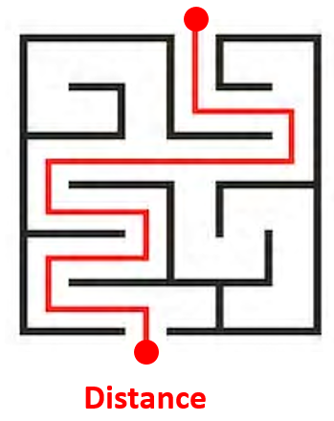
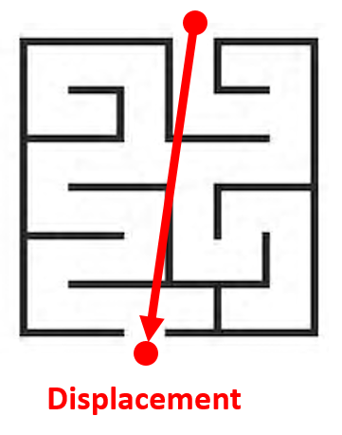
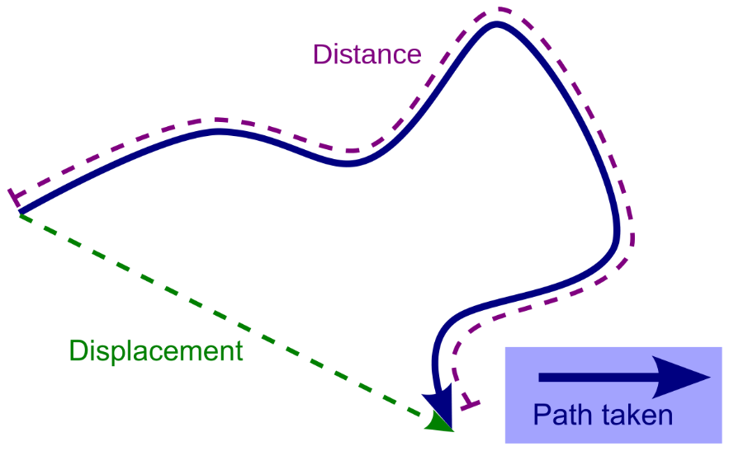
Distance
A scalar measure of the interval between two locations measured along the actual path connecting them
Displacement
A vector measure of the interval between two locations measured along the shortest path connecting them

Slide 6

Speed
Speed is the rate of change of distance with time.
distance
distance
distance
distance
time
time
Speed does not specify direction of movement.

Slide 7
Average speed vs. Instantaneous speed
Would you drive at the same speed all the way around?
slow
slow
medium
fast
Average speed is total distance / total time
Instantaneous speed is the speed at a particular instant in time

Slide 8
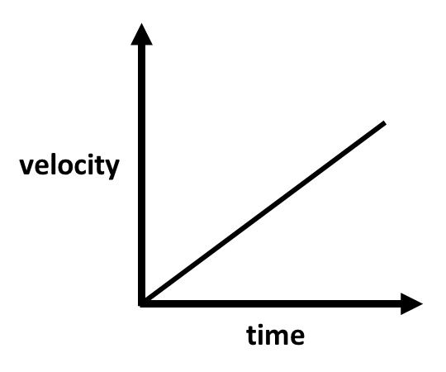
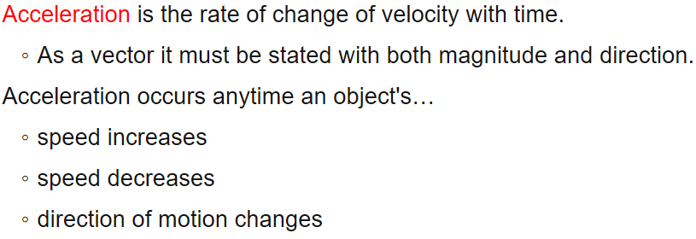
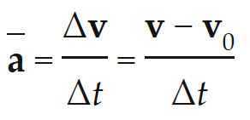
Acceleration
Acceleration is the rate of change of velocity with time.
Constant acceleration
Average acceleration
https://physics.info/acceleration/

Slide 9

This object is stationary.
We say that it is a body at rest, i.e. its velocity is zero.
If nothing happens to it, what will it do?
Nothing will happen.
It will remain at rest.
That seems reasonable …

Slide 10
This object is moving at a fixed velocity.
Nothing is pushing or pulling it.
What will it do?
fixed velocity
It will keep moving at the same velocity.
Think about that for a minute … it will keep moving, even though nothing is acting upon it!
Magic?!

Slide 11
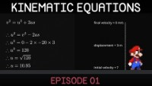
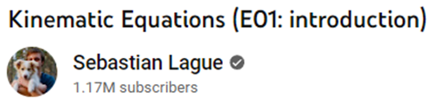
Let’s see how Newton’s laws apply to video games …
https://www.youtube.com/watch?v=v1V3T5BPd7E

Slide 12
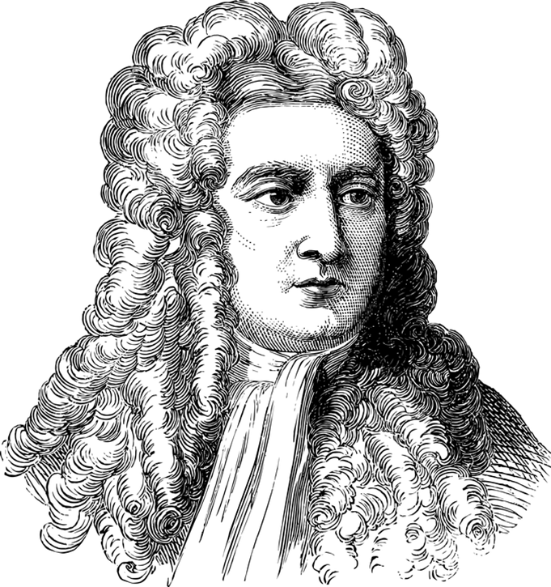
Newton’s First Law of Motion
“Every object persists in its state of rest or uniform motion in a straight line unless it is compelled to change that state by forces impressed upon it.”
This is the definition of inertia.
Simpler language
An object at rest stays at rest and an object in motion stays in motion with the same speed and in the same direction unless acted upon by an unbalanced force.
https://www.physicsclassroom.com/class/newtlaws/Lesson-1/Newton-s-First-Law
What are some examples of this in everyday life?!

Slide 13
Explain …
https://www.embibe.com/exams/newtons-law-and-its-real-life-applications/

Slide 14
Force is applied to the bottle to make it move
The base of the bottle applies the same force to the ketchup
A negative force is applied to the bottle to stop it
No negative force is applied to the ketchup, so it keeps moving (inside the bottle) due to its inertia
Even though the bottle has stopped moving, the ketchup keeps moving and eventually moves outside through the top

Slide 15
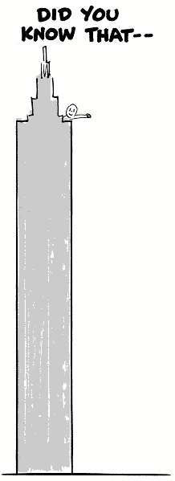


Newton’s 1st Law can also prove that the earth rotates
The ball keeps moving as the earth turns …
https://iwanttobeananimator.wordpress.com/2017/08/29/lesson-9-follow-through-and-overlapping/
http://www.dsource.in/course/principles-animation/follow-through-and-overlapping-action
https://www.academypendulums.com/pendulum/page12.htm

Slide 16
So is it magic?!
Newton's original ideas of "innate resistive force" were ultimately problematic for a variety of reasons, and thus most physicists no longer think in these terms.
As no alternate mechanism has been readily accepted, and it is now generally accepted that there may not be one which we can know, the term "inertia" has come to mean simply the phenomenon itself, rather than any inherent mechanism.
https://en.wikipedia.org/wiki/Inertia#Early_understanding_of_motion
“It is one of the primary unsolved mysteries of physics.”
In other words, we don’t yet know what’s going on.
https://www.quora.com/Do-physicists-know-what-exactly-causes-inertia
Mathematics models the universe, but doesn’t necessarily explain it!

Slide 17
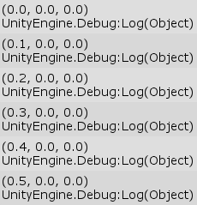
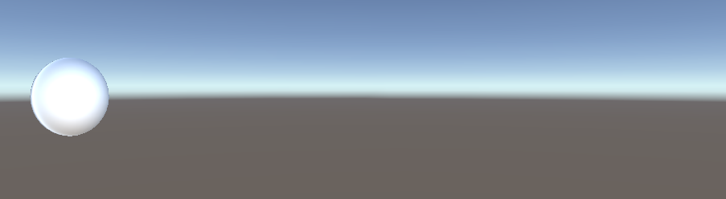
Let’s see what Unity does when a force is applied just once to a rigidbody (15 mins)
Create a scene and add a sphere with an attached rigidbody.
Add a script called FirstLaw to the sphere.
Remember ForceMode?
In the Start function, apply a force just once in the X direction.
Print out the position of the sphere after every frame.

Slide 18
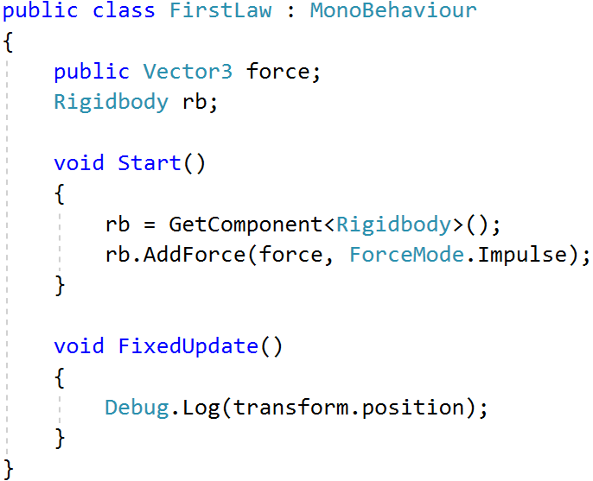
The change in X position is the same every frame.
What does this mean?
So (no surprise) the Unity physics engine obeys Newton’s First Law of Motion!
It means that the rigidbody now has a constant velocity.

Slide 19


Question
Constant velocity
50N
???
What is the opposite force on the box?
A. Greater than 50N
B. Equal to 50N
C. Less than 50N
D. Zero

Slide 20
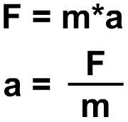
Newton’s Second Law of Motion
“Force is equal to the change in momentum (mass x velocity) per change in time.
For a constant mass, force equals mass x acceleration.”
What is momentum?
What is conservation of momentum?
Notes:
https://www.pinterest.com/pin/290341507211688088/
https://www.pinterest.com/pin/305963368420621492/

Slide 21
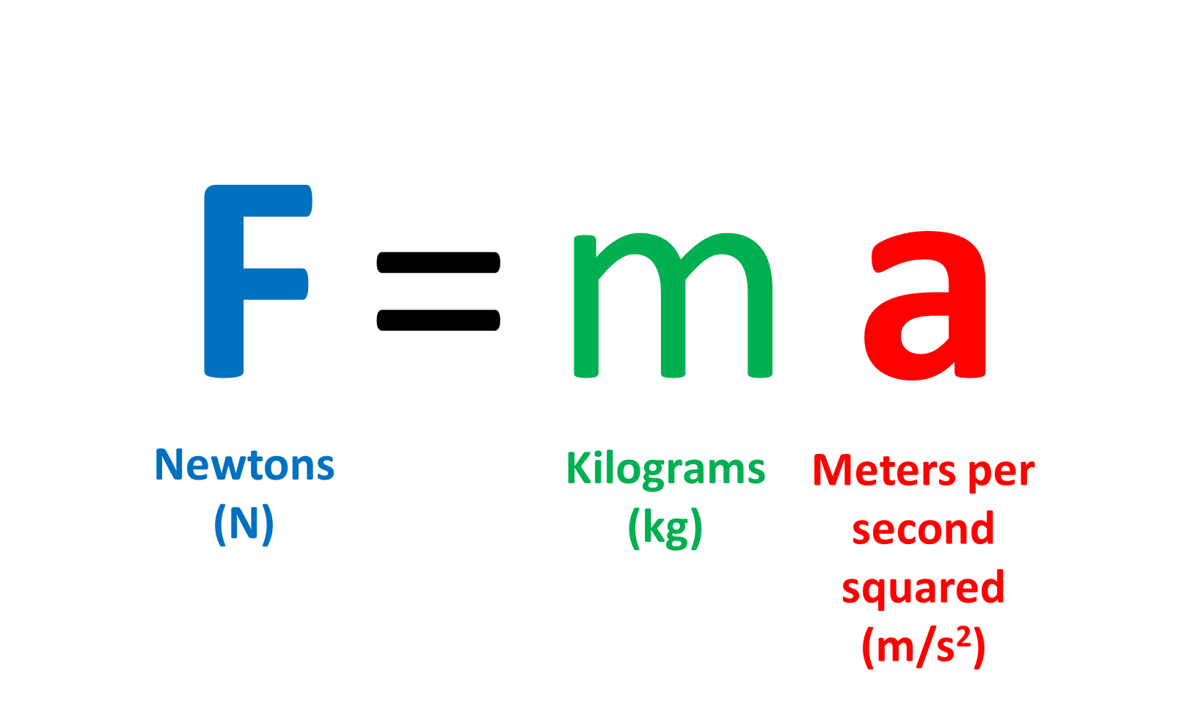
To simulate, you need to understand the units
F and a are in bold, which means that they are vectors, not scalar numbers
You may also see them with an arrow on top, which means the same thing

Slide 22
What does meters squared mean?
This means that we can define acceleration in terms of position over time.
Very useful when we come to the programming part!
Acceleration is a change in velocity.
Velocity is measured in meters per second (m/s)
Acceleration is (change in) velocity per second.
So, acceleration is
change in meters per second per second

Slide 23

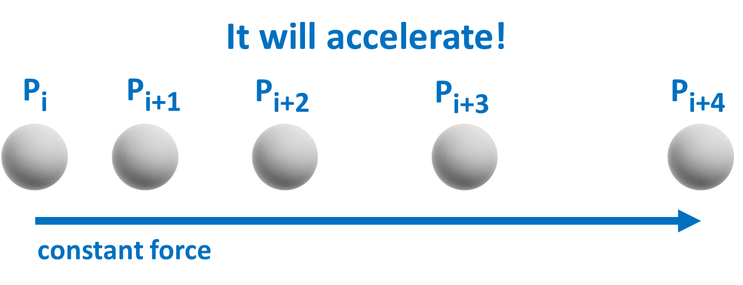
What happens when a force is applied constantly to an object?
Newton's second law says that when a constant force acts on a massive body, it causes it to accelerate, i.e., to change its velocity, at a constant rate.
https://www.livescience.com/46560-newton-second-law.html
Note: here, “massive” doesn’t mean huge– it means a body which has mass

Slide 24
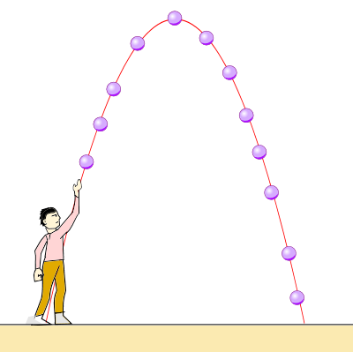
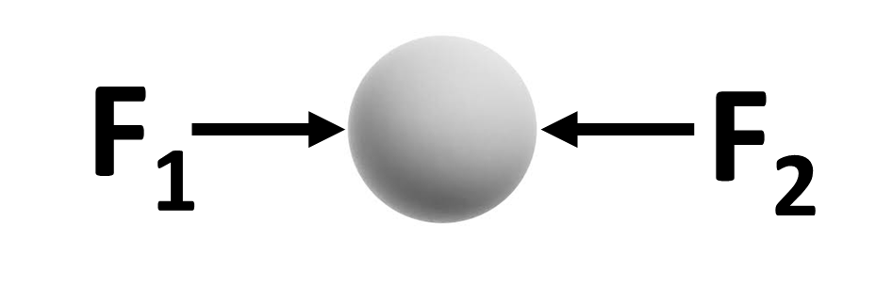
An object moves under the influence of all forces acting on it.
F_{total} = F₁ + F₂ + F₃ … +F_{n}
F₃
gravity
F₁
F₂
What will happen?

Slide 25
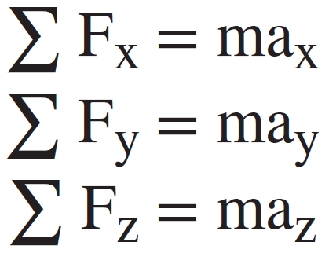
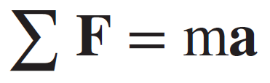
In 3D, the force and acceleration vectors have x, y, z components
This is generally true of most properties, e.g. velocity, displacement, momentum …
In 2D, there will only be x, y components

Slide 26
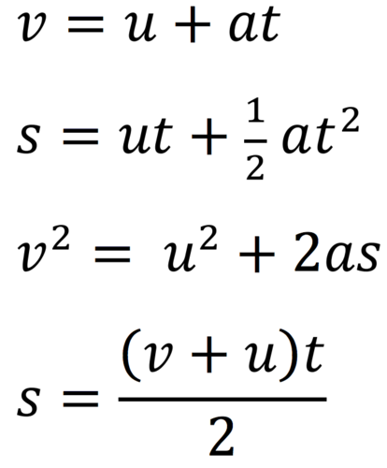
Kinematic equations
SUVAT
s from the latin spatium
s – displacement
u – initial velocity
v – final velocity
a – acceleration
t – time
Only use when acceleration is constant
http://physicsforidiots.com/physics/dynamics/

Slide 27

See how this equation is derived here:
Y velocity at time 0
https://tinyurl.com/wa8rmfbf
Height at time t
Height at time 0
P₁ = P₀ + v₀ t + 0.5 a t²
24
23
22
21
20.0
P₁ = 0 + 20 * 0.5 + 0.5 * -10 * 0.25 = 8.75
20
18.75
18.75
10 – 1.25
19
18
P₂ = 0 + 20 * 1.0 + 0.5 * -10 * 1.0 = 15
17
20 – 5
16
15.0
15.0
15
P₃ = 0 + 20 * 1.5 + 0.5 * -10 * 2.25 = 18.75
14
30 – 11.25
13
12
P₄ = 0 + 20 * 2 + 0.5 * -10 * 4 = 20.0
11
40 – 20
10
8.75
8.75
9
P₅ = 0 + 20 * 2.5 + 0.5 * -10 * 6.25 = 18.75
8
50 – 31.25
7
6
P₆ = 0 + 20 * 3 + 0.5 * -10 * 9 = 15
5
60 – 45
4
3
20 s⁻¹
P₇ = 0 + 20 * 3.5 + 0.5 * -10 * 12.25 = 8.75
2
70 – 61.25
1
P₈ = 0 + 20 * 4 + 0.5 * -10 * 16 = 8.75 = 0
t=0
t=0.5
t=1.0
t=1.5
t=2.0
t=2.5
t=3.0
t=3.5
t=4.0
80 – 80

Slide 28
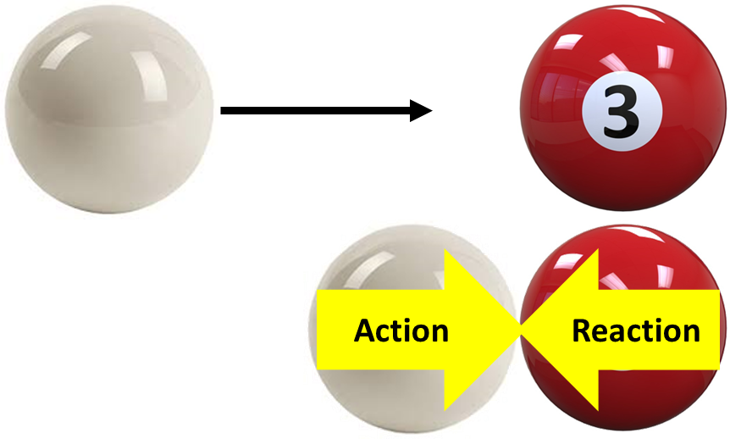
Newton’s Third Law of Motion
“For every action, there is an equal and opposite reaction.”
A good example is when two snooker balls collide. Here, the white ball applies a force to the red ball, which applies an equal and opposite force to the white ball.
This is important when dealing with collisions.
How objects react during collisions is closely related to the concept of Momentum, which we’ll look more in Part 2.

Slide 29

Activity
https://bit.ly/33LD1kw

Slide 30

Now do Part 1 of GMAPS__Dynamics_Kinematics.docx

